Slide 1
Machine Learning project
Project team
Sai sravan peddi
Elison Tuscano

Slide 2
Project Title:
Sentimental analysis on reviews using naïve bayes classifier

Slide 3
DATA SET:
SOURCE: http://ai.stanford.edu/~amaas/data/sentiment/
The data sets provided for the movie review are in two folders. One is the positive review and the other one is related to negative reviews.
Each review in both the folders is in separate text file.

Slide 4
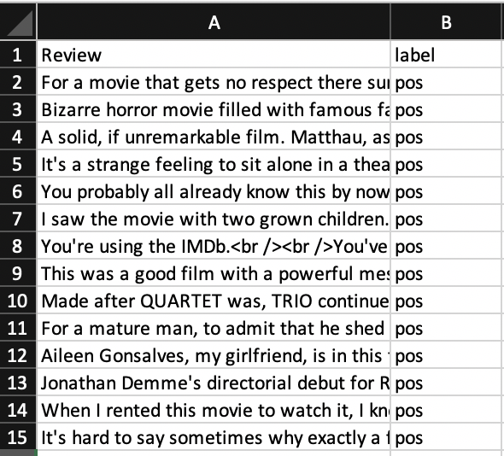
Data Preparation Process:
We created a file create_csv.py is used to take each review text file in both positive and negative folders and combine them into train.csv for training the model and test.csv for testing the model.

Slide 5
Data Preparation Process:
Removal of stop words like “and, the, this” which do not provide any crucial information for our model.
Removal of special characters like “! @ #” which creates confusion for our model are removed
Steaming and lemmatization are two techniques that can we used to analyse the reviews and reduce number of unique words in the dataset.
Finally representing the single review column into bag of vectors where each word is represented by 0 and 1.

Slide 6
Data preparation process:
After trying various methods, TF-idf vectorization algorithm is used to prepare the data and convert it into a bag of words.
TF-idf (term frequency-inverse document frequency) is a statistical measure that evaluates how relevant a word is to a document in a collection of documents.
Two metrics are multiplied to achieve this: how many times a word appears in a document, and the inverse document frequency of the word across a set of documents.

Slide 7
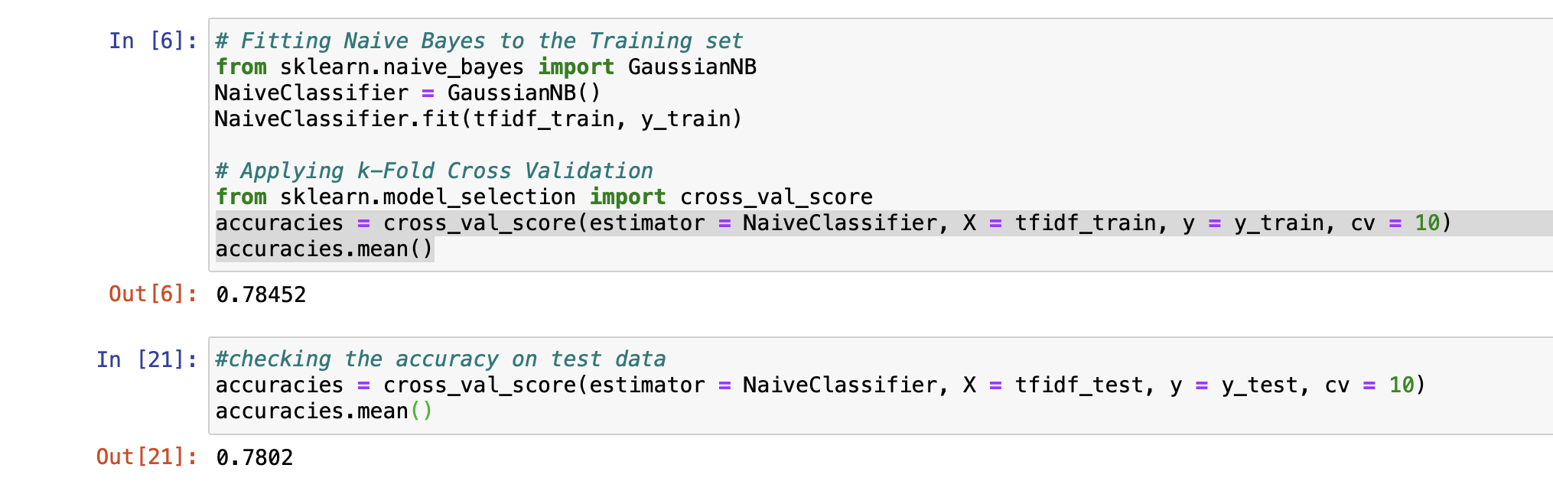
Implementation of Naïve Bayes:
After training the model using naïve Bayes the accuracy of the model is found to be 78% using 10-fold cross validation

Slide 8
Comparison with Random Forest algorithm:
In this we tried to create the classification model with random forest algorithm and see whether there is any improvement on the dataset that is available.
After training the model using Random Forest the accuracy of the model is found to be 79% using 10-fold cross validation.
This is not much improvement from the naïve Bayes algorithm.

Slide 9
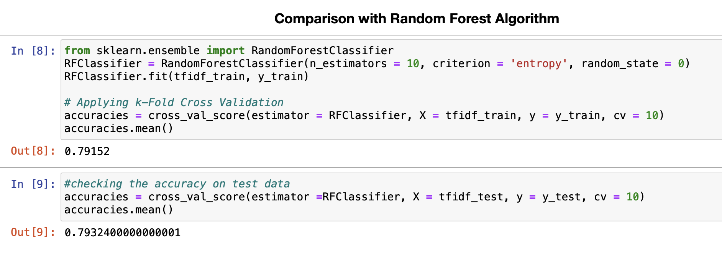

Slide 10
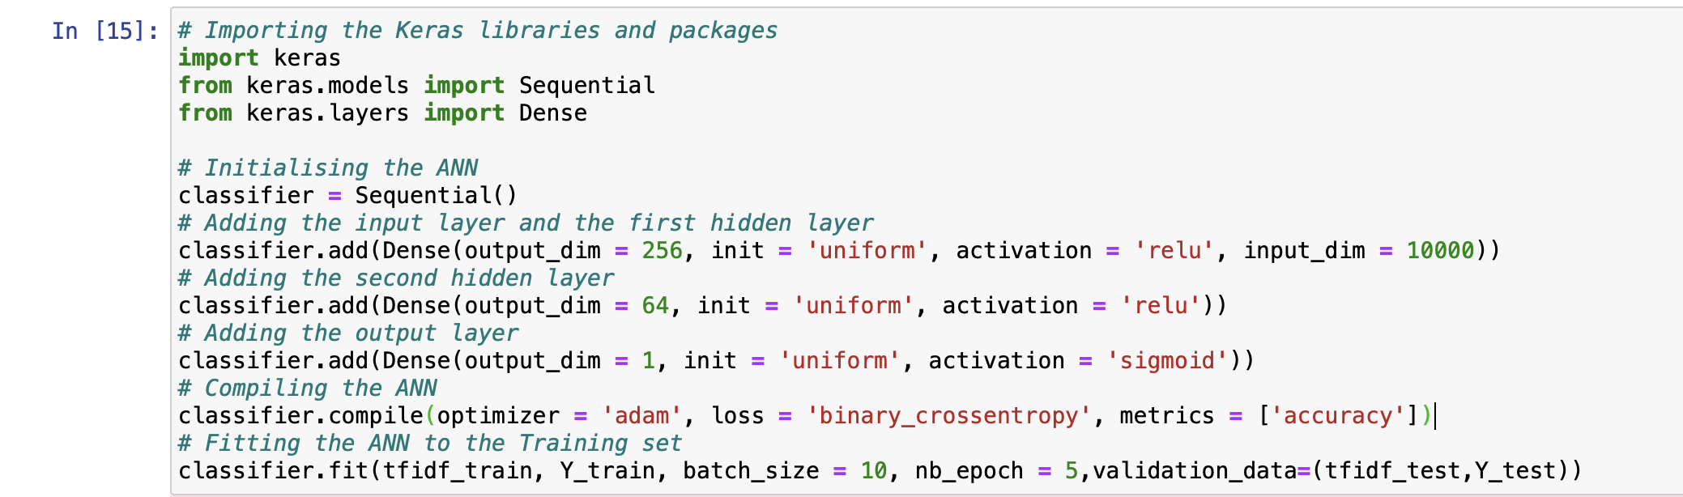
Enhancement with neural network:
Lets try to build a classification model using neural network and provide better accuracy than the above naïve bayes model.

Slide 11
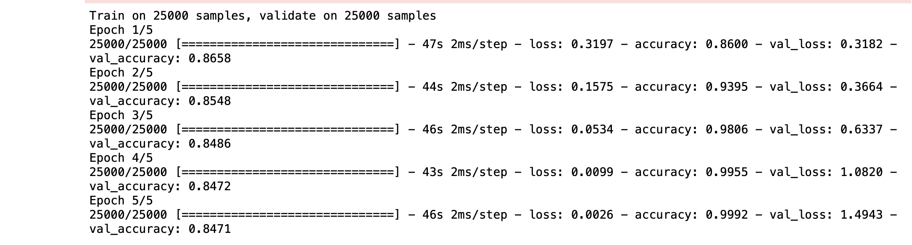
Enhancement with neural network:
The accuracy achieved with this approach on test data is around 85% which is more than the previous naïve Bayes model.

Slide 12
Difference from reference paper:
Using tf-idf vectorization to handle the data preparation.
Using Artificial neural network to create classification model.

Slide 13
Conclusion:
The original approach to create classification model using naïve Bayes approach gave us accuracy of 78% which was improved with the combination of tf-idf vectorization and artificial neural network whose accuracy was 85%.

Slide 14
Future scope:
Enhancing the accuracy with parameter tuning.
Reduce overfitting in artificial neural network.
Creating a user-friendly web GUI for the application.

Slide 15
THANK YOU

